Slide 1
District Advisory Council
December 13, 2022

Slide 2
District Advisory Council By-Laws
https://www.conejousd.org/

Slide 3
School-Connected Organizations
The Governing Board recognizes that parents/guardians and community members may wish to organize parent organizations and/or booster clubs for the purpose of supporting district and extracurricular programs, such as athletic teams, debate teams, or musical groups. The Board appreciates the contributions made by such organizations and encourages their interest and participation in supporting district activities and helping to achieve the district's vision for student learning.
CVUSD Board Policy 1230 - School-Connected Organizations

Slide 4
School-Connected Organizations
The Board recognizes that school-connected organizations are separate legal entities, independent of the district. However, in order to help the Board fulfill its legal and fiduciary responsibility to manage district operations, any school-connected organization that desires to raise money to benefit any district student shall submit a request for authorization to the Board, in accordance with Board policy and administrative regulation.
CVUSD Board Policy 1230 - School-Connected Organizations

Slide 5
School-Connected Organizations
Persons proposing to establish a school-connected organization shall submit a request to the Governing Board for authorization to operate at the school. Parent Teacher Associations (PTAs) will submit applications to the Conejo Council PTA in lieu of submission to the Governing Board. For the purposes of this AR, Parent Support Organizations include Parent/Booster Organizations and PTAs.
CVUSD Administrative Regulation 1230 - School-Connected Organizations

Slide 6
School Site Funding
General allocation to school based on enrollment
Additional federal funding to Title I elementary schools based on enrollment of low-income students.
Additional one-time funding
School-connected organizations - booster clubs, PTA, PFA
Notes:
LADERA - 56,000
MAPLE - 71,000
WALNUT - 100,000
MADRONA - 107,000
ACACIA - 122,000
GLENWOOD - 126,000
CONEJO - 133,000
https://www.cde.ca.gov/sp/sw/t1/authuseoffunds.asp

Slide 7
Range of Revenue and Expenditures
 | Revenue Range (2018/19) | Common Sources of Revenue | Common Expenditures
Elementary | $55,000 to $160,000 | Jog A Thon/Fun Run, Yearbook, Gift wrap, Book fair | PE Specialists, Technology, Music Specialists,
Middle School | $40,000 to $100,000 | Direct donation, Restaurant Night | Department materials, Hospitality
High School | $30,000 to $100,000 | Direct donations, Book sales | Teacher materials, Scholarships
Notes:
LADERA - 56,000
MAPLE - 71,000
WALNUT - 100,000
MADRONA - 107,000
ACACIA - 122,000
GLENWOOD - 126,000
CONEJO - 133,000
https://www.cde.ca.gov/sp/sw/t1/authuseoffunds.asp

Slide 8
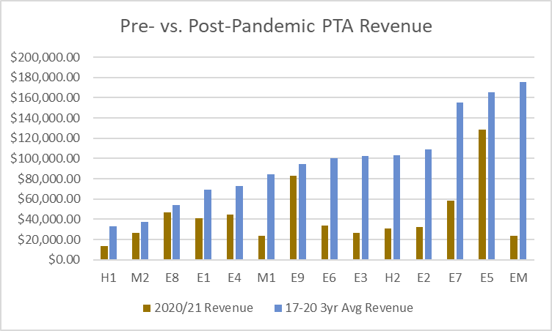
Impacts of the Pandemic
During the Fiscal Years (FY) 2017/18, 2018/19, and 2019/20, our 15 schools raised a total of $1.3M for school programs and improvements.
But during FY 2020/21, we only raised $615K, less than half of the money raised during prior years. On average, during the 2020/21 school year, our schools raised only 45.4 percent of their average revenue from the prior three years.

Slide 9
CVUSD Arts & Equity
Brian Peter, CVUSD Arts Coordinator

Slide 10
Conejo Schools Foundations
Lana Clark, Executive Director

Slide 11

Lana Clark
Executive Director

Slide 12

Who We Are:
The Conejo Schools Foundation is an independent 501 (c)(3) non-profit organization that supports Conejo Valley Unified School District programs and activities, its schools, teachers, and students. The Conejo Schools Foundation partners with the community to mobilize support and resources in order to protect, strengthen, and grow quality educational experiences for all CVUSD students.
Notes:
Authorized to fundraise on behalf of the district, myself and a part time office manager, otherwise run by volunteer board

Slide 13
How do we differ from a PTA/PFA?
Not school site specific; focus on district-wide initiatives
Provide programs and cover additional staff expenses

Slide 14




Our
Signature
Programs
Notes:
Just awarded 30K to 117 teachers at 28 sites. Will open for new submissions on January 9 open thru February 10
State of the Schools will be a lunch event this year, Tuesday, March 28 at Noon held at Cal Lutheran
All District will be returning to the Kavli Theatre for 7 nights featuring K-12 students in choir, strings and band. Appx 3200 student performers and 11,300 attendees
Get Ahead Program - summer school program for high school, offered online, two sessions in June/July
ALWAYS LOOKING FOR EVENT SPONSORS, PLEASE LET ME KNOW IF YOU OR SOMEONE YOU KNOW MAY BE INTERESTED

Slide 15
Past support:
Wellness Centers
Conejo Closet/Student Support
Breakthrough
Parent Outreach Program
HOP into Kindergarten/Conejo ES
Spelling Bee Registration
We the People
Music & Arts
Notes:
Wellness Centers – have provided funding for .5 FTE Mental Health Clinician to oversee the trainees
Conejo Closet – back packs with supplies in the fall as well general clothing and hygiene needs as well as special requests (soccer cleats, registration fees, etc.)
Breakthrough – webinar this evening Helping Your Child Find Balance
Parent Outreach – Thursday November 17 – 9th annual conference for Spanish speaking parents on Human communication
Music – instrument repair, focus on the arts teacher during online instruction

Slide 16
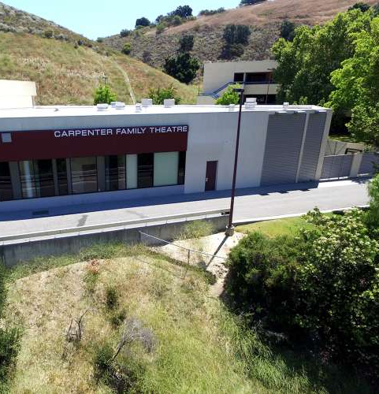
Focus on the Future
Endowment & Naming Opportunities
Expanded Summer Programming
Teacher Recognition
Additional Grant Offerings
Notes:
Carpenter Family Theatre at WHS, Julie Power Library at Westlake Hills ES, and Sage Library at NPHS – any site that recently used Measure I funds to build or renovate good candidates

Slide 17



How can you help us?
How can we help you?
Questions?
Make a gift
Become an event sponsor
Share a name or make an introduction
Identify projects for support

Slide 18
Thank
You!
Lana Clark
lana@conejoschools.org
www.conejoschools.org

Slide 19
Conejo Council PTA
Cathy Riggs, CCPTA President

Slide 20

District Advisory Council
Visual and Performing Arts
Update
Dec 13, 2022

Slide 21


Slide 22
Conejo Valley Unified School District Arts Planning Team:
Dr. Ricardo Araiza Director, Multilingual Learners and Equity
Julie Bernard, Art Specialist - Aspen / Parent
Katie Berry, Elementary Counselor
Elizabeth Blake, Teacher, Westlake H.S. & Los Cerritos M.S. Strings
Jason Branham, Administration - Principal, Westlake High School
Michael Freed, Long term sub, Los Cerritos M.S. Band
Alison Friedman, Art Teacher (credentialed) - Aspen Elementary
Cindy Goldberg, Trustee, Board of Education
Brynn Hutchison, General Ed Teacher (K-5) - Lang Ranch Elementary
Nicole Judd, Principal, Redwood Middle School
Kim Kilgore, Former CVUSD Strings Coach, Arts Parent, & Studio violinist
Frank Laguardia, Music teacher at MATES and CLU, Parent
Eric Lindroth, Teacher, NPHS - Photo
Kenneth Loo, Assistant Superintendent - Instructional Services
Beth Pearcey Neal, Acacia Magnet School / Small Business Owner
Brian Peter, VAPA Coordinator CVUSD / WHS Jazz Band Director
Alec Proudfit, Recent CVUSD Alumni, Strings Coach, photo & media company owner
Denise Reader, Conejo Schools Foundation
Niki Richardson, Director, TOArts
John Sargent, Newbury Park, Choir
Dr. Dena Sellers, Director, Elementary Education
Jonathan Serret, Cultural Affairs Director, City of Thousand Oaks
Marilyn Strange Teacher, Theatre, NPHS
Karen Surmani, CSUN Arts, Music Education, Student Teacher Supervisor, Parent
Karen Sylvester Trustee, Board of Education
Vivian Vina, Principal, Glenwood Elementary
Kirsten Walker, Principal on Special Assignment (POSA) - special education focus
Nicole Wall, Teacher (ELD & Art - Middle School) & ELD Advisor
Dr. Sonia Wilson, Director, Middle School Education
Peggy Burt, Arts Education Strategic Planning Facilitator, Mindful Strategies Consulting

Slide 23
Strengths seen from Strategic Arts Committee
Talent in the Arts (Professional-Artists, Dancers, musicians,film,actors)…. Parent Support Staff Collaboration Talented & innovative teachers & staff Our community loves the arts Teachers that love the arts Passion in the community for arts Community opportunity for student participation Dedicated students and community resources | Wealth of community resources Decision makers are listening to a coordinated voice Board Support Dedicated VAPA TOSA Parents want the arts Parent and Teacher Arts Support The students ability of creativity if given the opportunity Student passion for and engagement in the arts drives parents to become engaged.
Notes:
The arts allows prep times for academic teachers in schedule

Slide 24
Challenges seen by Strategic Arts Committee
Needing a change in culture Inadequate funding (dedicated) to keep momentum, equity, and continuity Equitable communication to diverse stakeholders Policies Insufficient Commitment to funding Need to focus on whole child, not just AP and college acceptance Funding Time in the day compared to other subjects CVUSD and state of CA Red Tape Finding dedicated people who have the time to do the actual work Multiple student groups with diverse needs Communication | Loss of class sections due to school enrollment forcing combinations of students of widely varied levels into the same classes. Coordination of arts programs, engineer pathways to allow all to work together towards a common arts goal. More arts integration across subjects, TK-12 School site autonomy versus coordinated decision-making at district level

Slide 25
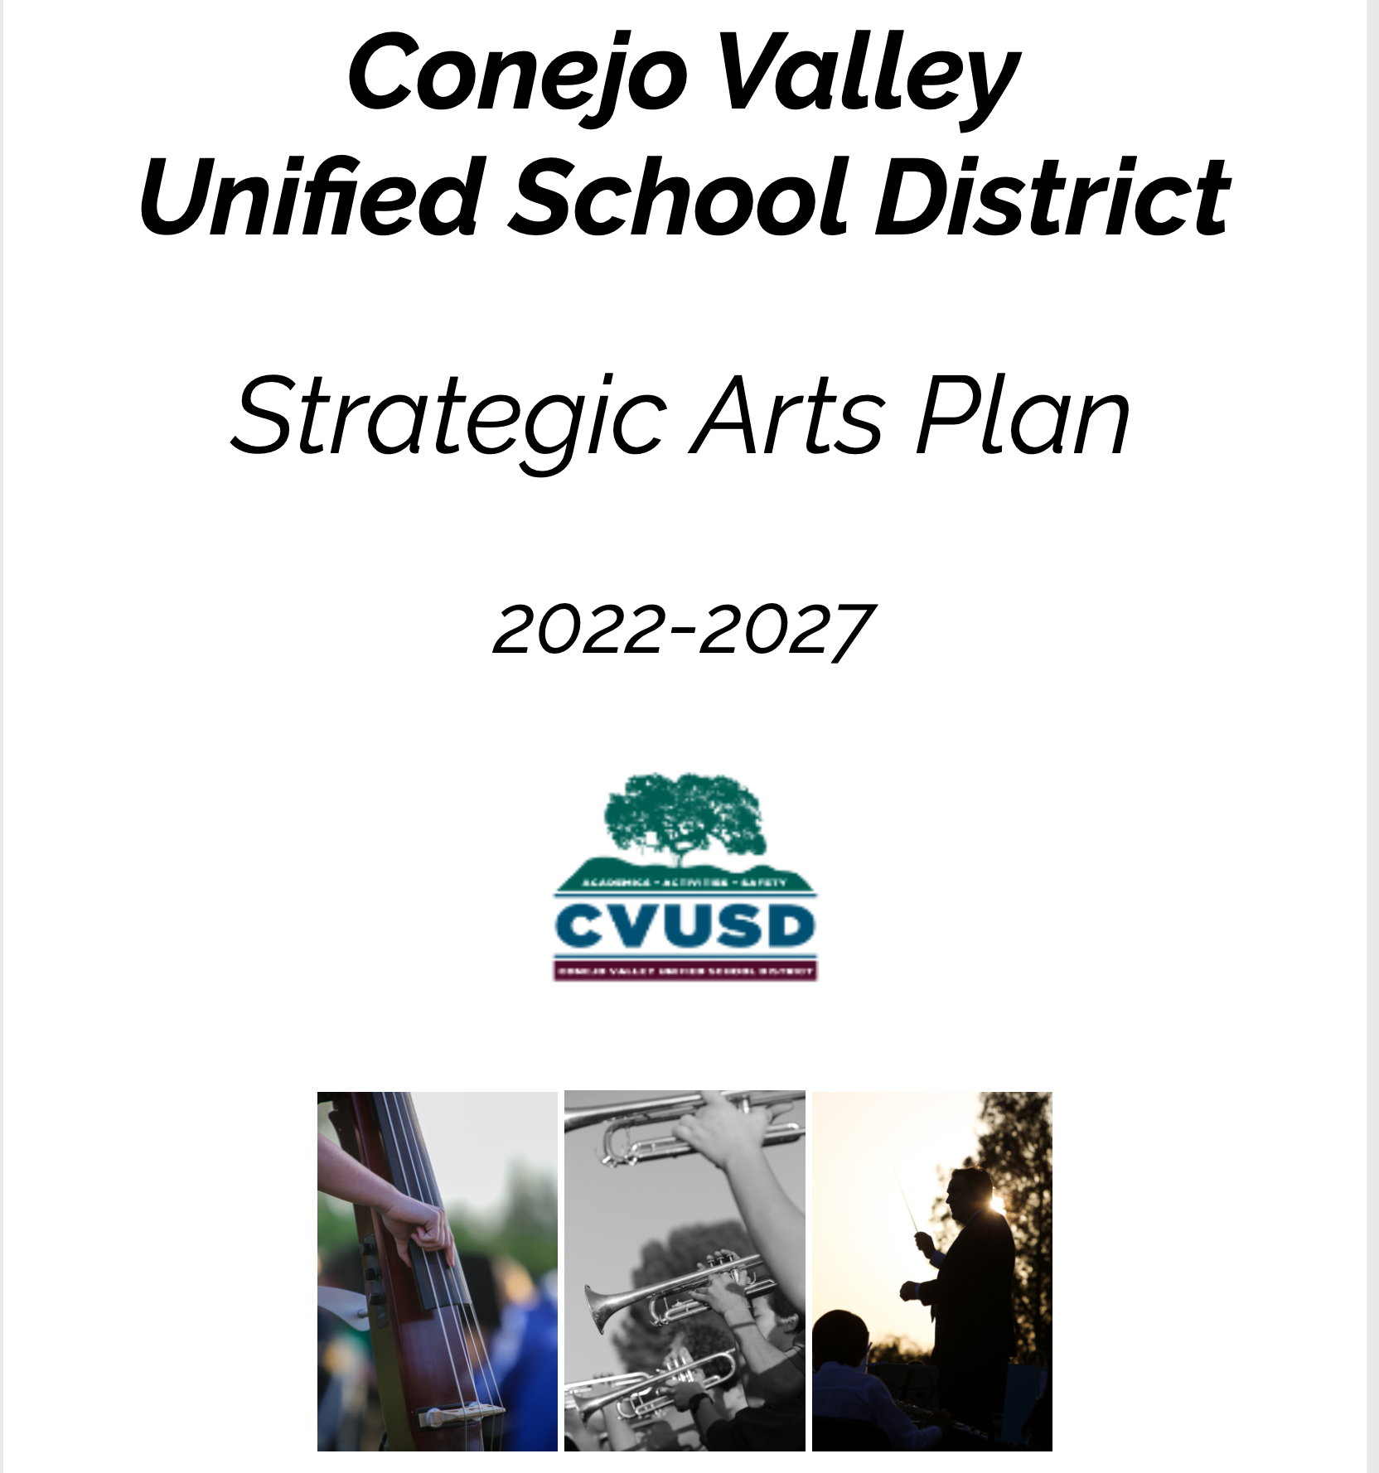

Slide 26
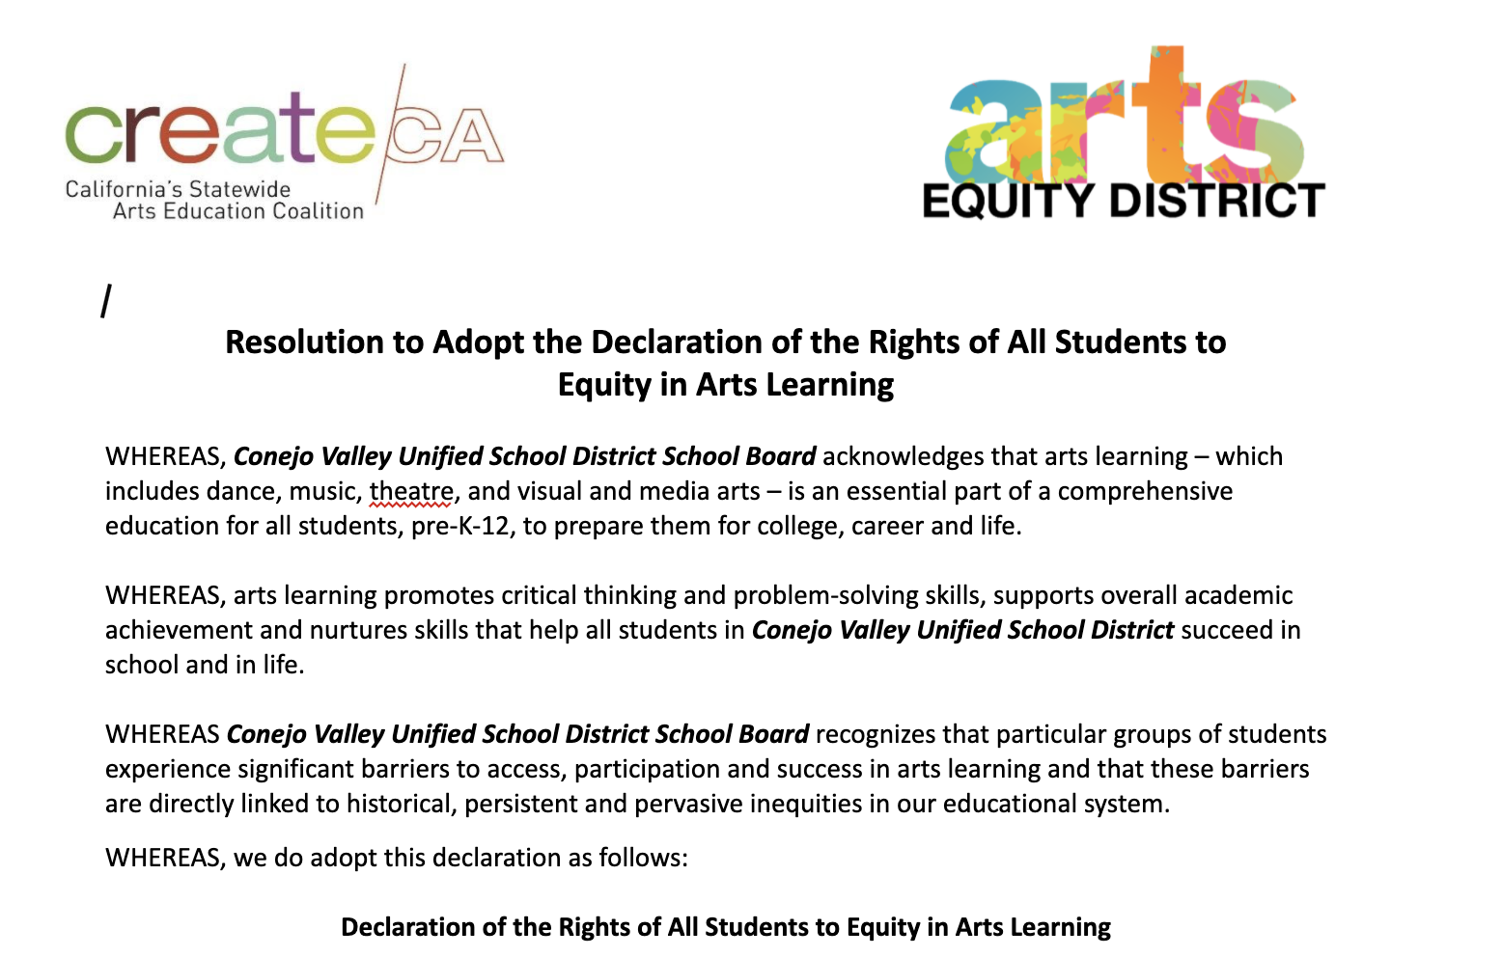
Model Resolution CVUSD Declaration of the Rights Equity in Arts Learning

Slide 27
CVUSD Solutions
Create & Implement a CVUSD Strategic Arts Plan
  (done, June 2022)
Adopt “Declaration of the Rights of All Students to Equity in Arts Learning”
  (done, June 2022)
One-Time Funding - Music & Arts Block Grant - $3 Million
  (August 2022)
Long Term Funding - Prop 28 - $2.2 Million unofficial
  (Nov 2022)
Demonstrate a TK-12 Coordinated Arts Education as Core Curriculum Through Action
  On going
Change Culture away from “Arts as an Enrichment Activity”
Our Schools are a Global TEAM to Achieve Student Equity to Arts Access
Accountability

Slide 28
SB181 Music & Arts Block Grant (2022)
Allocated from Governor's Budget ($2.2 billion total for CA VAPA)
One-time funds
Three years to spend
Funds not spent AFTER three years are swept
We can spend all at once, or over a 3-year period
CVUSD allocated $3 million towards the CVUSD Strategic Arts Plan
No real limitations on spending, just needs to be VAPA
CVUSD Board of Education and district leadership allocated these funds towards Strategic Arts Plan implementation
Many school districts did not allocate Music & Arts block grant funds to VAPA…

Slide 29
Prop 28 Passed! Thank you voters!
Funding starts fall 2023 and is ongoing each year
Funding is 70% based on total enrollment, and 30% on low-income students
80% of funding must go to staffing
Funds must supplement (add to) current VAPA programs, not supplant (replace).
Annual reporting to CA is a requirement
No other big details have been released
CCSESA, LACOE, Peggy Burt, etc. pushing Ca Dept of Ed for details
CDE will make final decisions
CVUSD guesstimate is $2.2 Million annually, 80% is apx $1.75 Million
Many questions still unanswered

Slide 30
Prop 28 Challenges
Entire State of CA is now hunting for Arts Educators
Credentialed, Experienced, and Qualified VAPA Teachers are Rare
Conejo Valley is Expensive
We want to move quick to recruit and hire the best!
CVUSD Advantages to Recruitment:
Strategic Arts Plan
Dedicated VAPA Coordinator
Funding
BOE & Administrative Investment
Community Support of Visual and Performing Arts

Slide 31
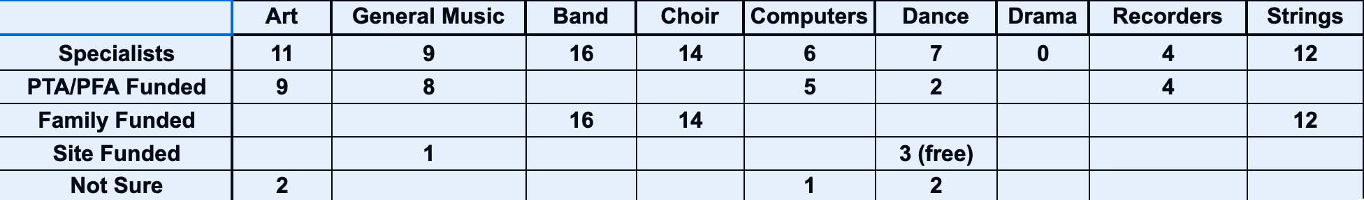
Where We Were:
Previous Elementary Data,17 Sites - as of Sept 2021
Specialists supported by:
PTA/PFA
Family Funded (CRPD fee based)
Site Funded (Instruction / Title 1)

Slide 32
‘22/’23 Implemented CVUSD VAPA Programs
Four Theater Arts Integration PDs at Civic Arts Center: TOArts
Credentialed General Music Teachers in all 4th and 5th grade classes in CVUSD
Purchased 35 soprano Ukuleles, 7-piece Peripole Orff mallet Instruments, frame drums, diatonic boomwhackers, octavators, gathering drum, shakers, & rhythm sticks for all 17 elementary sites.
Saavas Elem General Music Curriculum - Karen Surmani, CSUN professor and elem music Saavas editor & specialist on staff
$3 million in one-time block grant dollars to be spent on TK-12 VAPA programs over the next 2.5 years. Program teachers and principals will budget together.
  Significant investment in instruments, equipment, PD, maintenance, repair, instruction, & specialists
Prop 28 ongoing funding towards long term staffing and ongoing expenses.

Slide 33
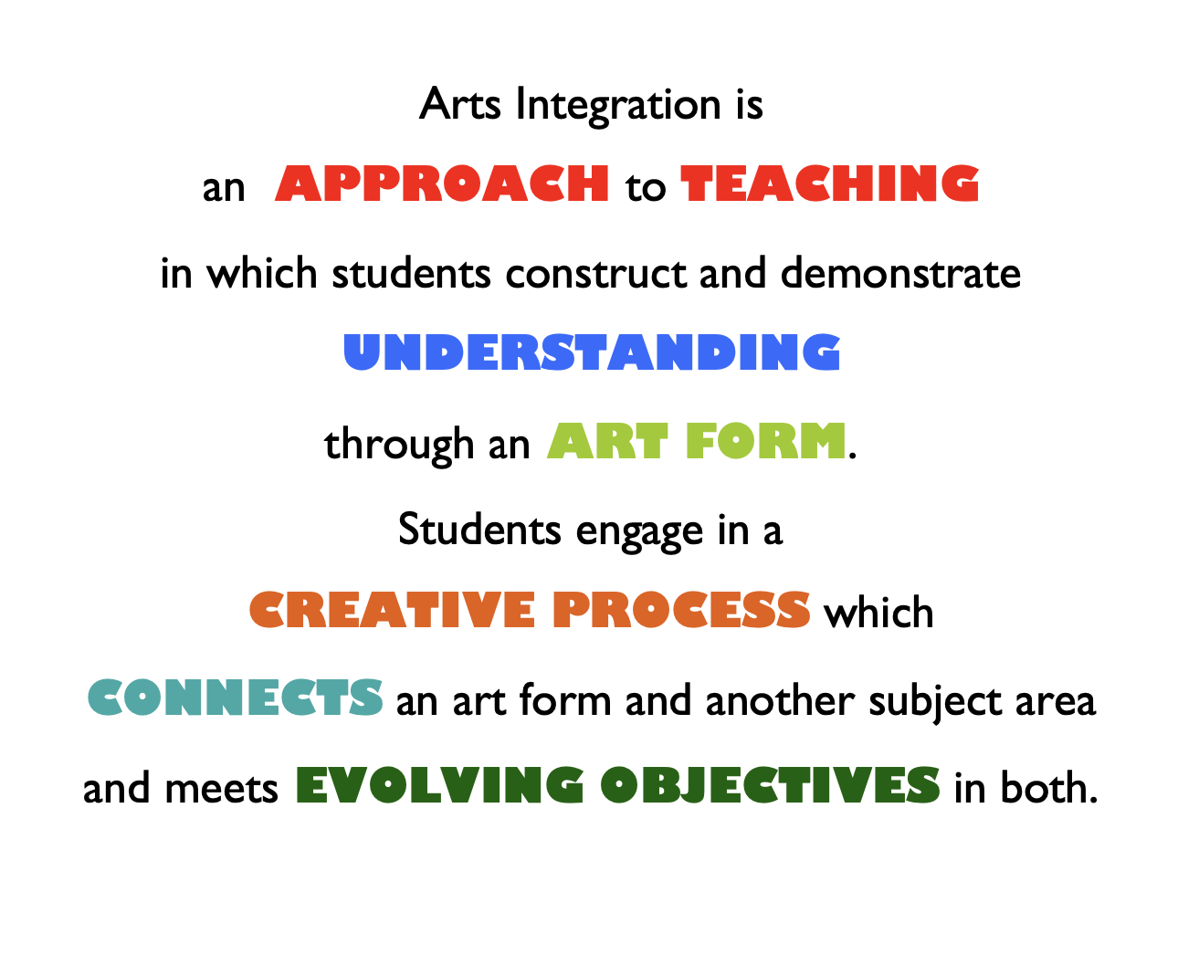
What is Arts Integration
Kennedy Center Definition

Slide 34
Ellis Island: Theater Arts Integration
My 3rd grade students read articles and books about Ellis Island (both fiction and non-fiction), explored maps and graphs about immigrant statistics, went onto an interactive Ellis Island website, and watched videos about Ellis Island's and the Statue of Liberty's history.
Practiced "Go, Drop, Melt" and the statues exercise.
Ellis Island Image Tableau - I wanted this experience to help my students prepare for their Ellis Island simulation which is tomorrow (dressing up, role playing immigrants entering Ellis Island/USA, etc.)
  Gave each group of students a photo of a scene from Ellis Island.
  Had them plan their scene and how they would place their bodies, show expression on their faces, be in levels, etc., to visually show what was happening in their photo.
  Had them "1, 2, 3...tableau" and freeze in their tableau positions while their classmates guessed what Ellis Island scene they were re-enacting in their tableau.
  Showed the photo with their tableau to have their classmates compare and the tableau participants comment on.
  Kids LOVED doing this and shared that this experience will help them really BE immigrants tomorrow as it will give them the confidence to play their part well because they understand how the immigrants felt going through this challenge in the late 1890s and early 1900s.

Slide 35
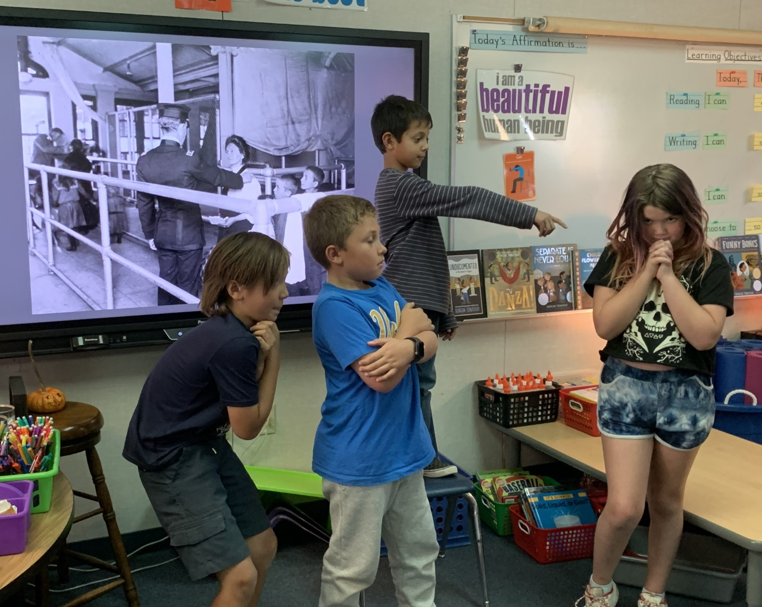
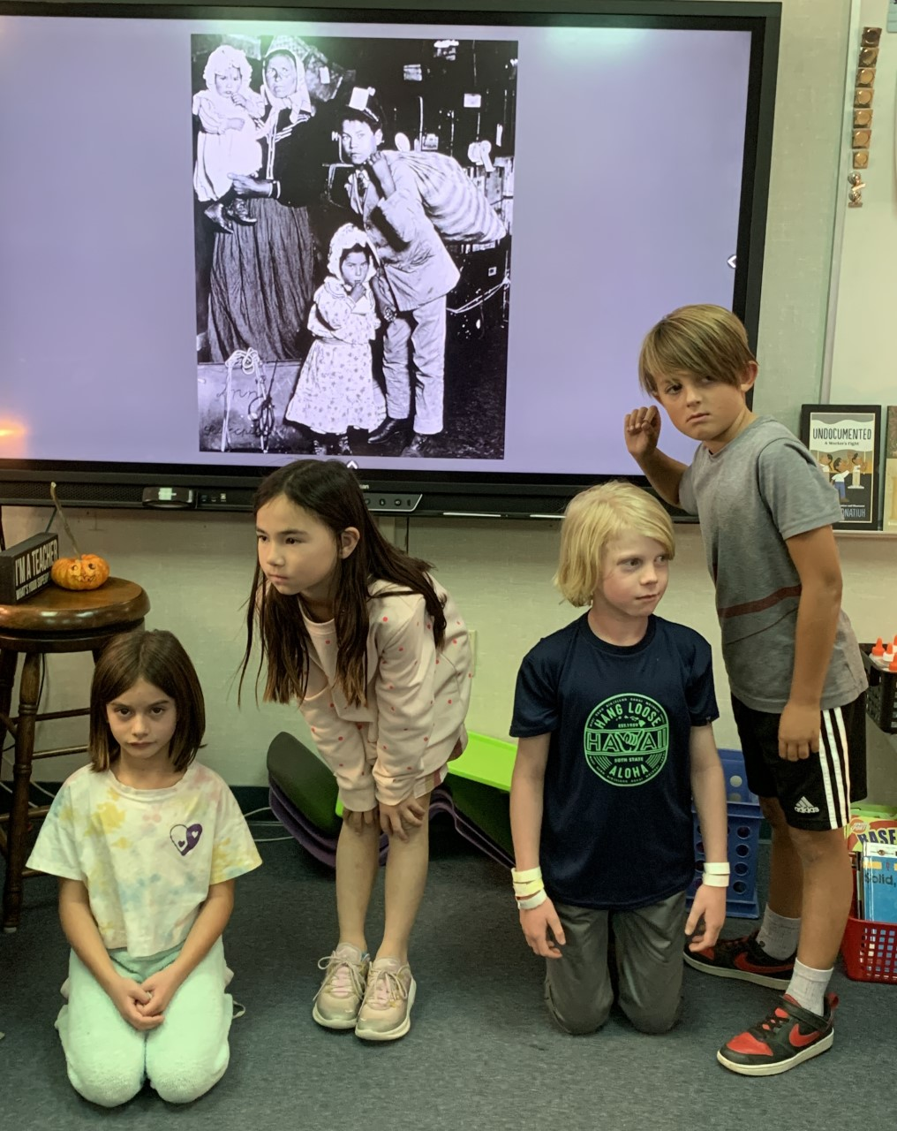
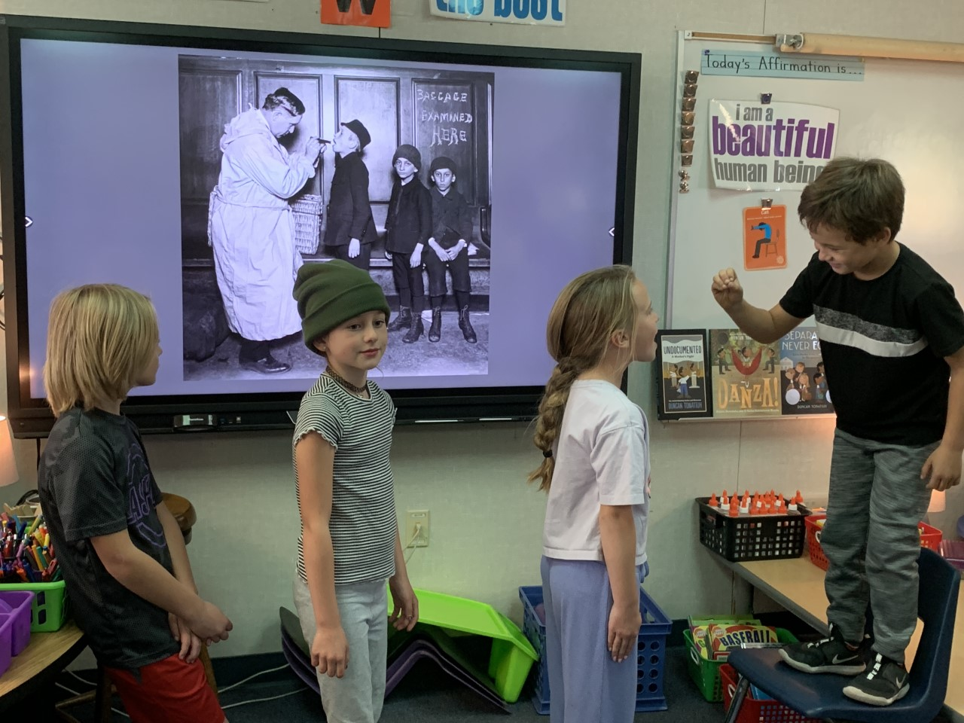

Slide 36



Thank you!

Slide 37
Discussion Questions
What types of PTA/PFA fundraisers are at your school?
What kind of fundraising activities have been more successful especially since the pandemic began?
What is one thing you're proud of that's been provided by your PTA/PFA?
In light of what we've just learned, do you think your PTA/PFA funding priorities might change? What might be your school's "wish list"? What can our existing fundraising organizations do to help?

Slide 38
Newbury Park High School Theatre Presents "Mamma Mia!"
Under the Direction of NPHS Teacher, Ms. Marilyn Strang

Slide 39
Happy Holidays!
You are so important for us

